Slide 2
.NET Aspire: Cloud-Native Without the Chaos
Emiliano Montesdeoca
Cloud Dev Team lead @ Intelequia
Microsoft MVP Developer Technologies
@emimontesdeocaa

Slide 3

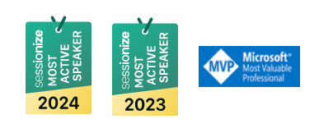

Emiliano Montesdeoca – the tattoo guy!
You can call me Emi
Cloud Dev Team Lead
Microsoft MVP ~2022
Uruguayan + Spanish
X: @emimontesdocaa
Others: @emimontesdeoca
@emimontesdeocaa

Slide 4
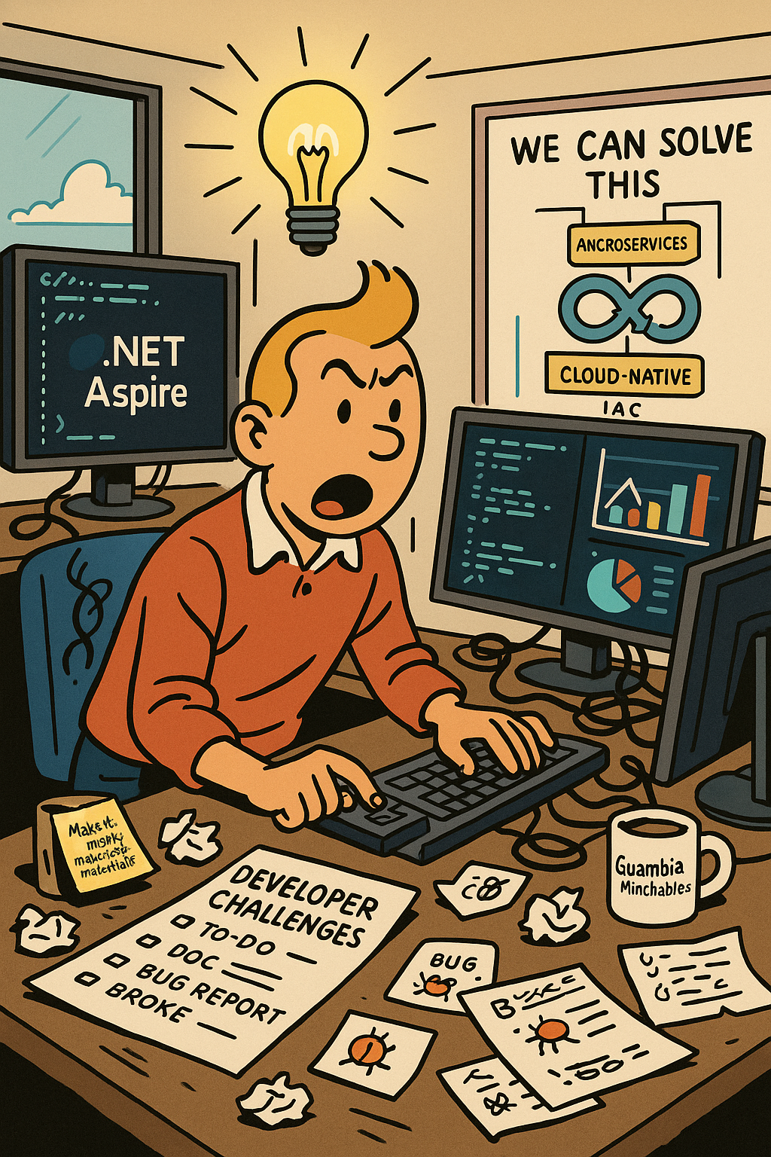
Agenda
Struggles of developer experience
How can we solve this?
Developer challenges
.NET Aspire
Demo
@emimontesdeocaa

Slide 5
Struggles of developer experience
@emimontesdeocaa

Slide 6

What is Developer Experience?
Refers to the overall experience and satisfaction that developers have while using tools, platforms, and processes to build software.
It encompasses everything that affects a developer’s ability to perform their tasks efficiently and enjoyably.
Impact on Productivity and Efficiency
Quality of software
Developer satisfaction and retention
@emimontesdeocaa

Slide 7
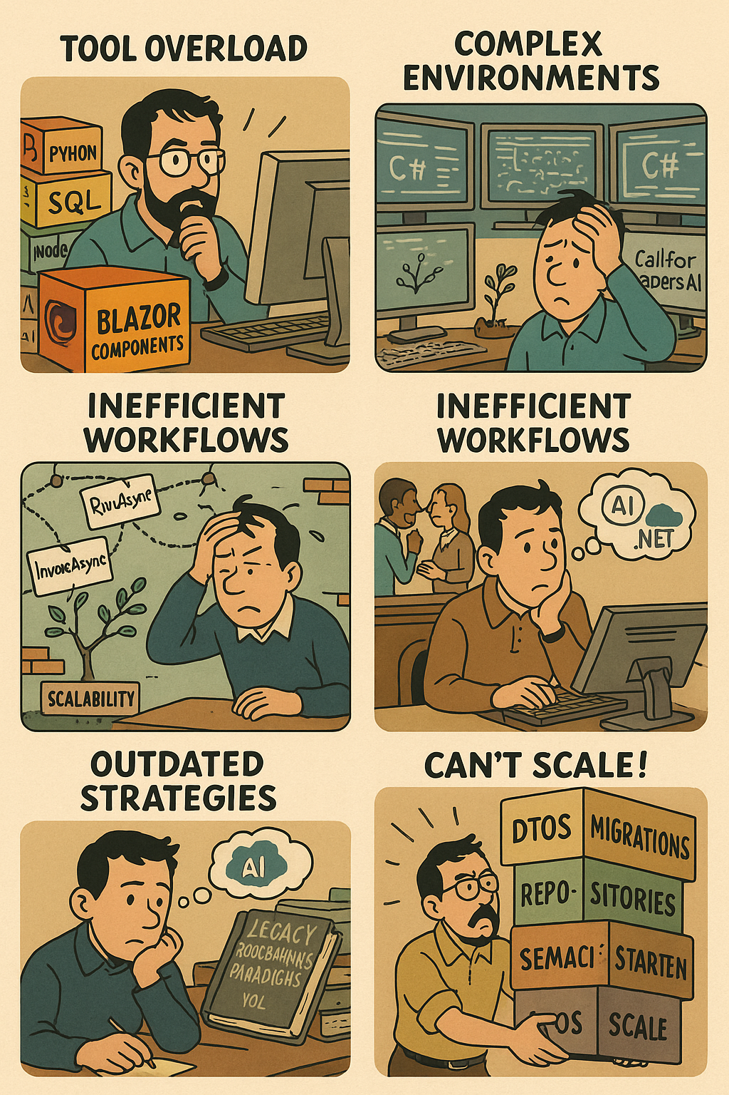
Challenges Developers Face Today
Tool Overload
Complex environments
Limited Scalability
Inefficient Workflows
Knowledge Silos
Outdated strategies
Can’t scale!
@emimontesdeocaa

Slide 8
How can we solve this?
@emimontesdeocaa

Slide 9
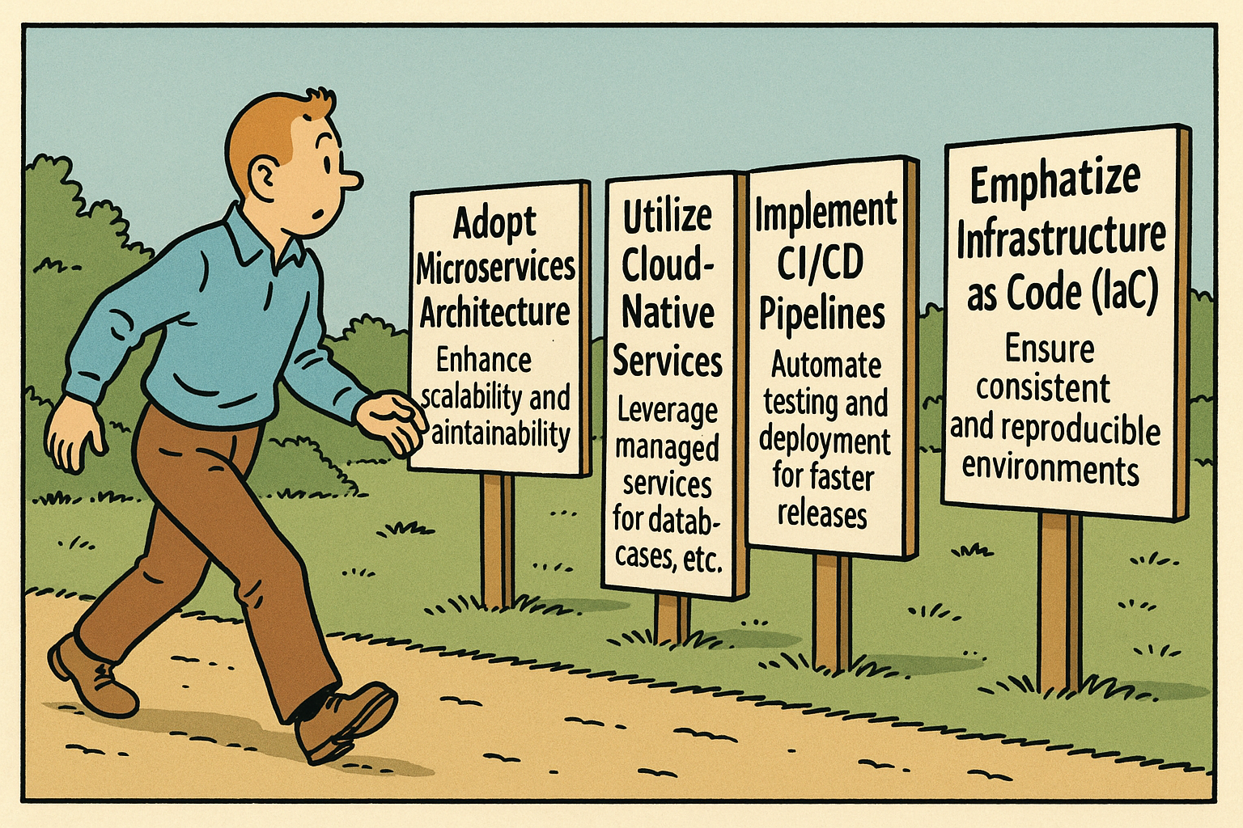
Strategies for Building Cloud Apps
Adopt Microservices Architecture: Enhance scalability and maintainability.
Utilize Cloud-Native Services: Leverage managed services for databases, caching, etc.
Implement CI/CD Pipelines: Automate testing and deployment for faster releases.
Emphasize Infrastructure as Code (IaC): Ensure consistent and reproducible environments.
Monitor and Optimize Performance: Use monitoring tools to track and improve app performance.
@emimontesdeocaa

Slide 10
Challenges Developers Face Today
Tool Overload
Complex environments
Limited Scalability
Inefficient Workflows
Knowledge Silos
Outdated strategies
Can’t scale!
@emimontesdeocaa

Slide 11
.NET Aspire
@emimontesdeocaa

Slide 12
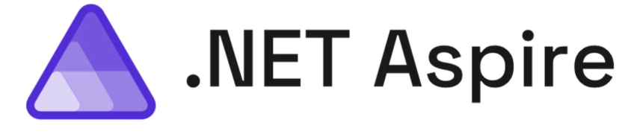
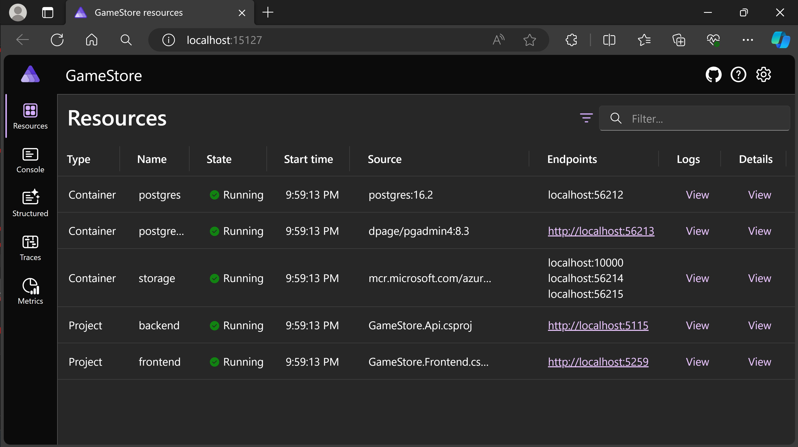
.NET Aspire – an overview of a godsent tool
Provides tools, templates, and packages to help you build observable, production-ready apps.
Delivered through NuGet packages, .NET Aspire simplifies common challenges in modern app development.
@emimontesdeocaa

Slide 13
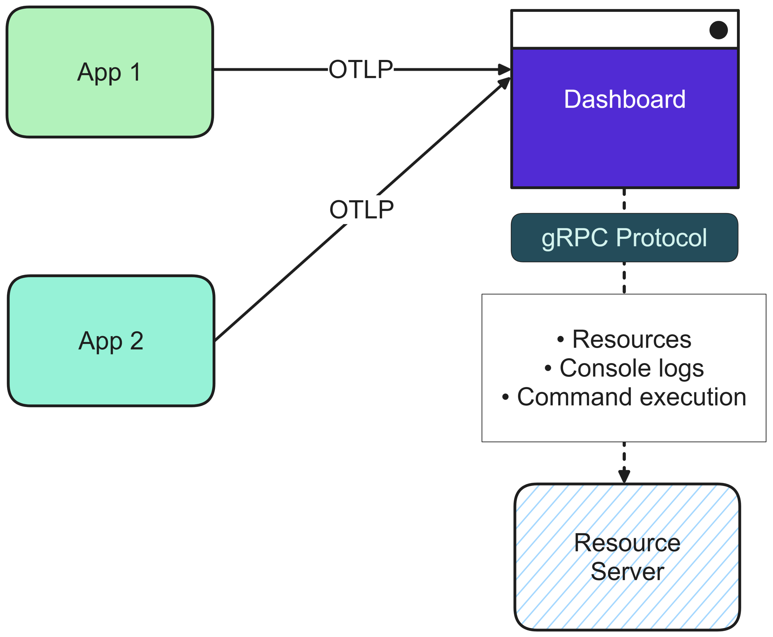
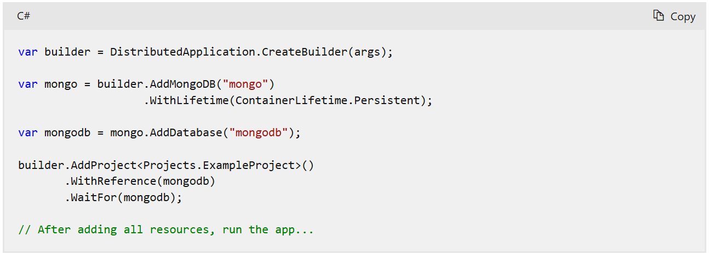
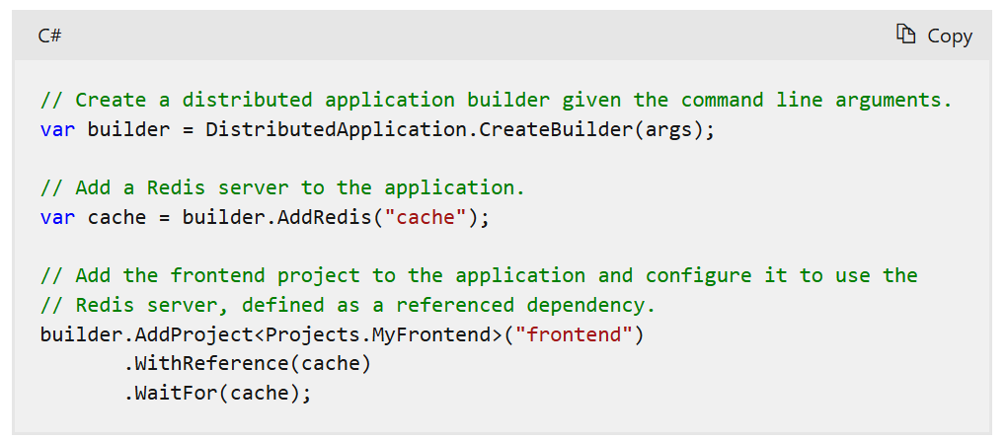
.NET Aspire – 3 main characteristics
Dev-time orchestration
.NET Aspire integrations
Project templates and tooling
Orchestration primarily focuses on enhancing the local development experience by simplifying the management of your app's configuration and interconnections.
Integrations are NuGet packages designed to simplify connections to popular services and platforms, such as Redis or PostgreSQL.
.NET Aspire provides a set of project templates and tooling experiences for Visual Studio, Visual Studio Code, and the .NET CLI.
@emimontesdeocaa

Slide 14
Demo!
@emimontesdeocaa

Slide 15
References
https://github.com/emimontesdeoca/global-azure-2025-accra-net-aspire
https://aka.ms/aspire
https://devblogs.microsoft.com/dotnet/category/dotnet-aspire/
https://x.com/davidfowl
https://x.com/emimontesdeocaa

